Slide 1
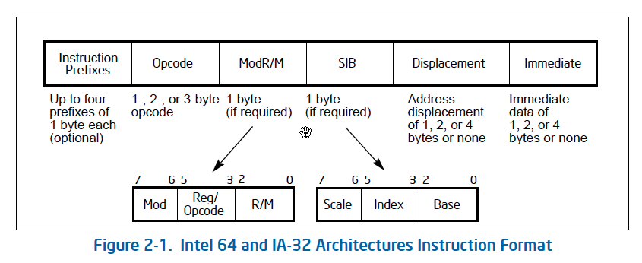
x86 Encoding

Slide 2
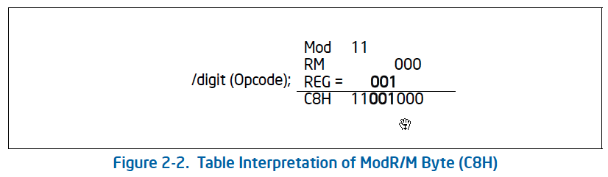
x86 Encoding

Slide 3
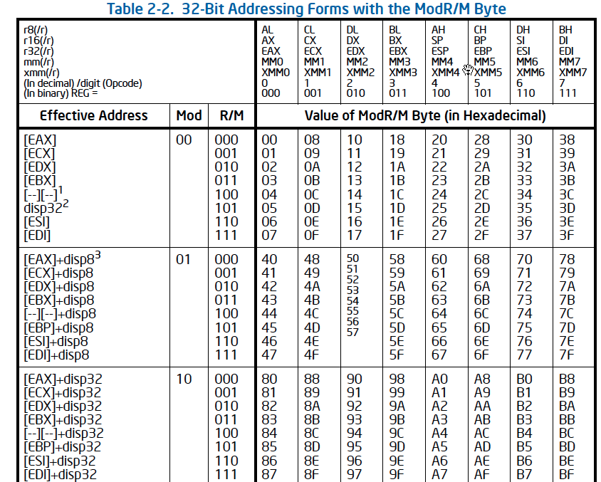
x86 Encoding

Slide 4
Object Code
Setup
  Label .L49 becomes address 0x804875c
  Label .L57 becomes address 0x8048bc0
08048718 <unparse_symbol>:
8048718: 55 pushl %ebp
8048719: 89 e5 movl %esp,%ebp
804871b: 8b 45 08 movl 0x8(%ebp),%eax
804871e: 83 f8 05 cmpl $0x5,%eax
8048721: 77 39 ja 804875c <unparse_symbol+0x44>
8048723: ff 24 85 c0 8b jmp *0x8048bc0(,%eax,4)

Slide 5
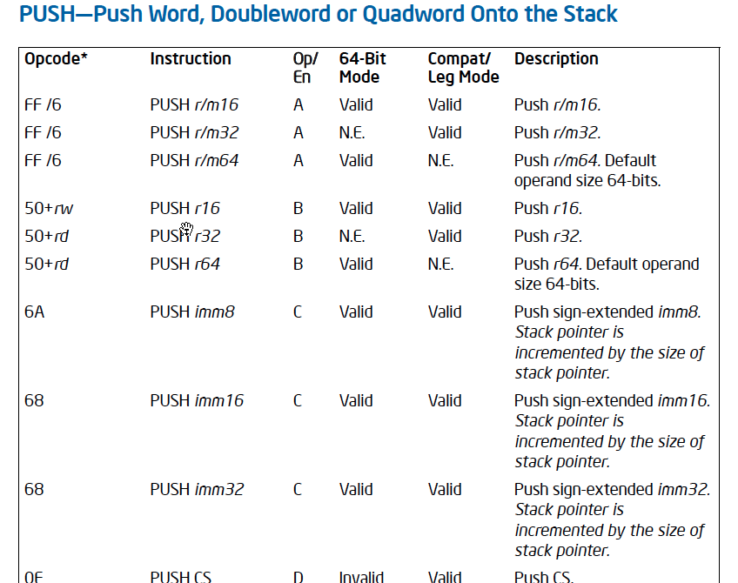

Slide 6
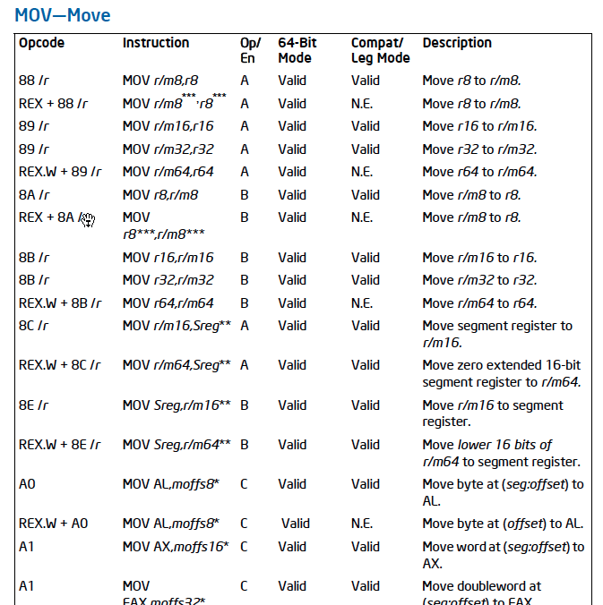

Slide 7
Object Code
89 e5 movl %esp,%ebp
  Opcode: 89
  modRM (mod R/M reg)
  11 100 (esp) 101 (ebp)
08048718 <unparse_symbol>:
8048718: 55 pushl %ebp
8048719: 89 e5 movl %esp,%ebp
804871b: 8b 45 08 movl 0x8(%ebp),%eax
804871e: 83 f8 05 cmpl $0x5,%eax
8048721: 77 39 ja 804875c <unparse_symbol+0x44>
8048723: ff 24 85 c0 8b jmp *0x8048bc0(,%eax,4)

Slide 8
Object Code
8b 45 08 movl 0x8(%ebp),eax
  Opcode: 8b
  modRM (mod R/M reg)
  01 000 (eax) 101 (ebp)
08048718 <unparse_symbol>:
8048718: 55 pushl %ebp
8048719: 89 e5 movl %esp,%ebp
804871b: 8b 45 08 movl 0x8(%ebp),%eax
804871e: 83 f8 05 cmpl $0x5,%eax
8048721: 77 39 ja 804875c <unparse_symbol+0x44>
8048723: ff 24 85 c0 8b jmp *0x8048bc0(,%eax,4)

Slide 9
Y86-64 Instructions
Format
  1–10 bytes of information read from memory
    Can determine instruction length from first byte
    Not as many instruction types, and simpler encoding than x86-64
  Each accesses and modifies some part(s) of the program state

Slide 10
Y86-64 Instruction Set #1
Byte
0
1
2
3
4
5
6
7
8
9
halt
0
0
nop
1
0
cmovXX rA, rB
2
fn
rA
rB
irmovq V, rB
3
0
F
rB
V
rmmovq rA, D(rB)
4
0
rA
rB
D
mrmovq D(rB), rA
5
0
rA
rB
D
OPq rA, rB
6
fn
rA
rB
jXX Dest
7
fn
Dest
call Dest
8
0
Dest
ret
9
0
pushq rA
A
0
rA
F
popq rA
B
0
rA
F

Slide 11
Y86-64 Instruction Set #2
rrmovq
2
0
Byte
0
1
2
3
4
5
6
7
8
9
cmovle
2
1
halt
0
0
cmovl
2
2
nop
1
0
cmove
2
3
cmovXX rA, rB
2
fn
rA
rB
cmovne
2
4
irmovq V, rB
3
0
F
rB
V
cmovge
2
5
rmmovq rA, D(rB)
4
0
rA
rB
D
cmovg
2
6
mrmovq D(rB), rA
5
0
rA
rB
D
OPq rA, rB
6
fn
rA
rB
jXX Dest
7
fn
Dest
call Dest
8
0
Dest
ret
9
0
pushq rA
A
0
rA
F
popq rA
B
0
rA
F

Slide 12
Y86-64 Instruction Set #3
Byte
0
1
2
3
4
5
6
7
8
9
halt
0
0
nop
1
0
cmovXX rA, rB
2
fn
rA
rB
irmovq V, rB
3
0
F
rB
V
rmmovq rA, D(rB)
4
0
rA
rB
D
addq
6
0
mrmovq D(rB), rA
5
0
rA
rB
D
subq
6
1
OPq rA, rB
6
fn
rA
rB
andq
6
2
jXX Dest
7
fn
Dest
xorq
6
3
call Dest
8
0
Dest
ret
9
0
pushq rA
A
0
rA
F
popq rA
B
0
rA
F

Slide 13
Y86-64 Instruction Set
Byte
0
1
2
3
4
5
6
7
8
9
2
0
rrmovq
halt
0
0
2
1
cmovle
2
2
cmovl
2
3
nop
1
0
cmove
2
4
cmovne
2
5
cmovXX rA, rB
2
fn
rA
rB
cmovge
2
6
cmovg
irmovq V, rB
3
0
F
rB
V
rmmovq rA, D(rB)
4
0
rA
rB
D
mrmovq D(rB),rA
5
0
rA
rB
D
OPq rA, rB
6
fn
rA
rB
7
0
jXX Dest
7
fn
Dest
jmp
jle
7
1
call Dest
8
0
Dest
7
2
jl
ret
9
0
addq
7
3
6
0
je
subq
pushq rA
A
0
rA
F
6
1
7
4
jne
6
2
andq
7
5
popq rA
B
0
rA
F
jge
xorq
6
3
7
6
jg

Slide 14
Y86-64 Processor State
RF: Program registers
CC: Condition codes
Stat: Program status
%rax
%rsp
%r8
%r12
%rcx
%rbp
%r9
%r13
ZF
SF
OF
DMEM: Memory
%rdx
%rsi
%r10
%r14
PC
%rbx
%rdi
%r11
  Program Registers
    15 registers (omit %r15). Each 64 bits
  Condition Codes
    Single-bit flags set by arithmetic or logical instructions
      ZF: Zero SF:Negative OF: Overflow
  Program Counter
    Indicates address of next instruction
  Program Status
    Indicates either normal operation or some error condition
  Memory
    Byte-addressable storage array
    Words stored in little-endian byte order

Slide 15
Encoding Registers
Each register has 4-bit ID
  Same encoding as in x86-64
Register ID 15 (0xF) indicates “no register”
  Will use this in our hardware design in multiple places
%rax
0
%r8
8
%rcx
1
%r9
9
%rdx
2
%r10
A
%rbx
3
%r11
B
%rsp
4
%r12
C
%rbp
5
%r13
D
%rsi
6
%r14
E
%rdi
7
No Register
F

Slide 16
Instruction Example
Addition Instruction
  Add value in register rA to that in register rB
    Store result in register rB
    Note that Y86-64 only allows addition to be applied to register data
  Set condition codes based on result
  e.g., addq %rax,%rsi Encoding: 60 06
  Two-byte encoding
    First indicates instruction type
    Second gives source and destination registers
Generic Form
Encoded Representation
addq rA, rB
6
0
rA
rB

Slide 17
Arithmetic and Logical Operations
Instruction Code
Function Code
Add
  Refer to generically as “OPq”
  Encodings differ only by “function code”
    Low-order 4 bytes in first instruction word
  Set condition codes as side effect
addq rA, rB
6
0
rA
rB
Subtract (rA from rB)
subq rA, rB
6
1
rA
rB
And
andq rA, rB
6
2
rA
rB
Exclusive-Or
xorq rA, rB
6
3
rA
rB

Slide 18
Move Operations
Register ➔ Register
rrmovq rA, rB
2
0
rA
rB
Immediate ➔ Register
irmovq V, rB
3
0
F
rB
V
Register ➔ Memory
rmmovq rA, D(rB)
4
0
rA
rB
D
Memory ➔ Register
mrmovq D(rB), rA
5
0
rA
rB
D
  Like the x86-64 movq instruction
  Simpler format for memory addresses
  Give different names to keep them distinct

Slide 19
Move Instruction Examples
X86-64
Y86-64
movq $0xabcd, %rdx
irmovq $0xabcd, %rdx
$0xabcd: 00 00 00 00 00 00 ab cd
Encoding:
30 f2 cd ab 00 00 00 00 00 00
movq %rsp, %rbx
rrmovq %rsp, %rbx
Encoding:
20 43
movq %rsi,0x41c(%rsp)
rmmovq %rsi,0x41c(%rsp)
Encoding:
40 64 1c 04 00 00 00 00 00 00
movq -12(%rbp),%rcx
mrmovq -12(%rbp),%rcx
Encoding:
50 15 f4 ff ff ff ff ff ff ff

Slide 20
Conditional Move Instructions
Move Unconditionally
rrmovq rA, rB
2
0
rA
rB
  Refer to generically as “cmovXX”
  Encodings differ only by “function code”
  Based on values of condition codes
  Variants of rrmovq instruction
    (Conditionally) copy value from source to destination register
Move When Less or Equal
cmovle rA, rB
2
1
rA
rB
Move When Less
cmovl rA, rB
2
2
rA
rB
Move When Equal
cmove rA, rB
2
3
rA
rB
Move When Not Equal
cmovne rA, rB
2
4
rA
rB
Move When Greater or Equal
cmovge rA, rB
2
5
rA
rB
Move When Greater
cmovg rA, rB
2
6
rA
rB

Slide 21
Jump Instructions
Jump (Conditionally)
jXX Dest
7
fn
Dest
  Refer to generically as “jXX”
  Encodings differ only by “function code” fn
  Based on values of condition codes
  Same as x86-64 counterparts
  Encode full destination address
    Unlike PC-relative addressing seen in x86-64

Slide 22
Jump Instructions
Jump Unconditionally
jmp Dest
7
0
Dest
Jump When Less or Equal
jle Dest
7
1
Dest
Jump When Less
jl Dest
7
2
Dest
Jump When Equal
je Dest
7
3
Dest
Jump When Not Equal
jne Dest
7
4
Dest
Jump When Greater or Equal
jge Dest
7
5
Dest
Jump When Greater
jg Dest
7
6
Dest

Slide 23
Y86-64 Program Stack
Stack “Bottom”
  Region of memory holding program data
  Used in Y86-64 (and x86-64) for supporting procedure calls
  Stack top indicated by %rsp
    Address of top stack element
  Stack grows toward lower addresses
    Top element is at highest address in the stack
    When pushing, must first decrement stack pointer
    After popping, increment stack pointer
•
•
•
Increasing
Addresses
%rsp
Stack “Top”

Slide 24
Stack Operations
pushq rA
A
0
rA
F
  Decrement %rsp by 8
  Store word from rA to memory at %rsp
  Like x86-64
  Read word from memory at %rsp
  Save in rA
  Increment %rsp by 8
  Like x86-64
popq rA
B
0
rA
F

Slide 25
Subroutine Call and Return
call Dest
8
0
Dest
  Push address of next instruction onto stack
  Start executing instructions at Dest
  Like x86-64
  Pop value from stack
  Use as address for next instruction
  Like x86-64
ret
9
0

Slide 26
Miscellaneous Instructions
nop
1
0
  Don’t do anything
  Stop executing instructions
  x86-64 has comparable instruction, but can’t execute it in user mode
  We will use it to stop the simulator
  Encoding ensures that program hitting memory initialized to zero will halt
halt
0
0

Slide 27
Y86 Code Generation Example
x86 Code
Y86 Code
len2:
pushq %rbp
movq %rsp,%rbp
xorq %rcx,%rcx
movq 8(%rbp),%rdx
movq (%rdx),%rax
jmp .L26
len2:
pushq %rbp # Save %ebp
rrmovq %4sp,%rbp # Set frame
xorq %rcx,%rcx # len = 0
mrmovq 8(%rbp),%rdx # Get a
mrmovq (%rdx),%rax # Get *a
jmp .L26 # Goto entry

Slide 28
Y86 Code Generation Example
x86 Code
  Loop + Finish
Y86 Code
  Loop + Finish
L24:
movq (%rdx),%rax
incq %rcx
L26:
addq $4,%rdx
testq %rax,%rax
jne L24
movq %rbp,%rsp
movq %rcx,%rax
popq %rbp
ret
L24:
mrmovq (%rdx),%rax # Get *a
irmovq $1,%rsi
addq %rsi,%rcx # len++
L26: # Entry:
irmovq $4,%rsi
addq %rsi,%rdx # a++
andq %rax,%rax # *a == 0?
jne L24 # No--Loop
rrmovq %rbp,%rsp # Pop
rrmovq %rcx,%rax # Rtn len
popq %rbp
ret

